Slide 1
SuperPower Vision Group Team Training
Third Training
Header-Only Lib & Algorithms
Jiawei Liu => jaway.liu@gmail.com
2019/10/13

Slide 2
Today, you’ll learn:
Code Specification.
Header-Only Library.
Classifier.
MSER Algorithm.

Slide 3
Code Specification
/01

Slide 4
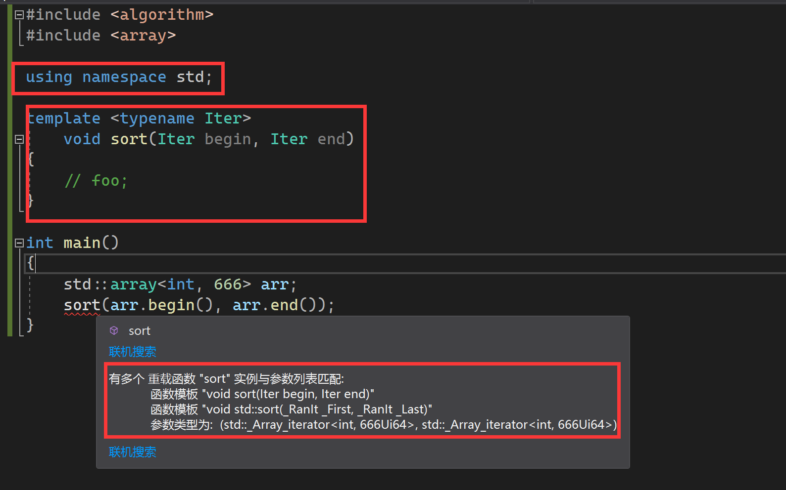
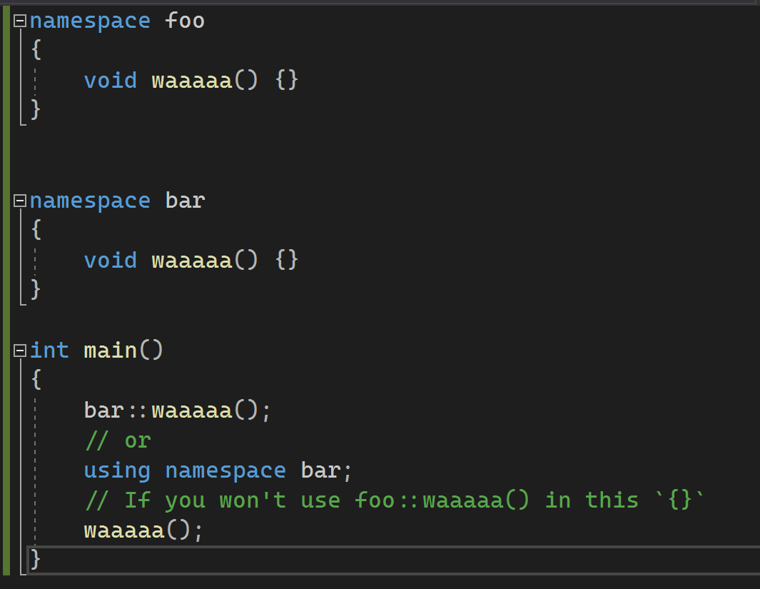
Do not use Global Namespace

Slide 5
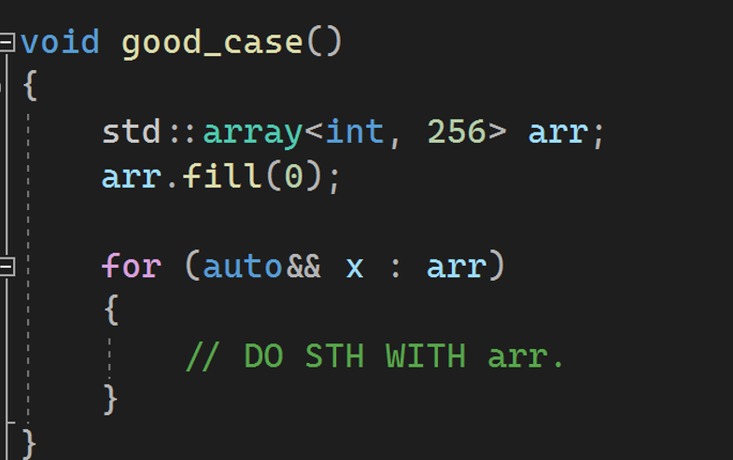
Use STL container NOT C Style Arrays

Slide 6
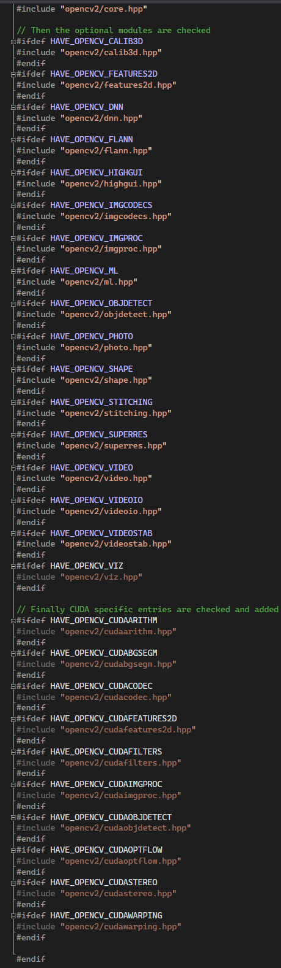
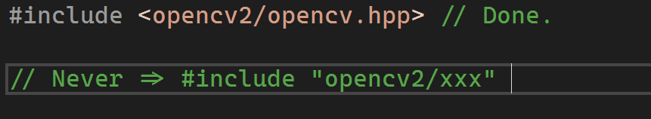
Headers …

Slide 7
Variable Naming
camelCase
Suggested, but not necessary.
snake_case(what STL do)
PascalCase

Slide 8
Header-only Lib
/02

Slide 9
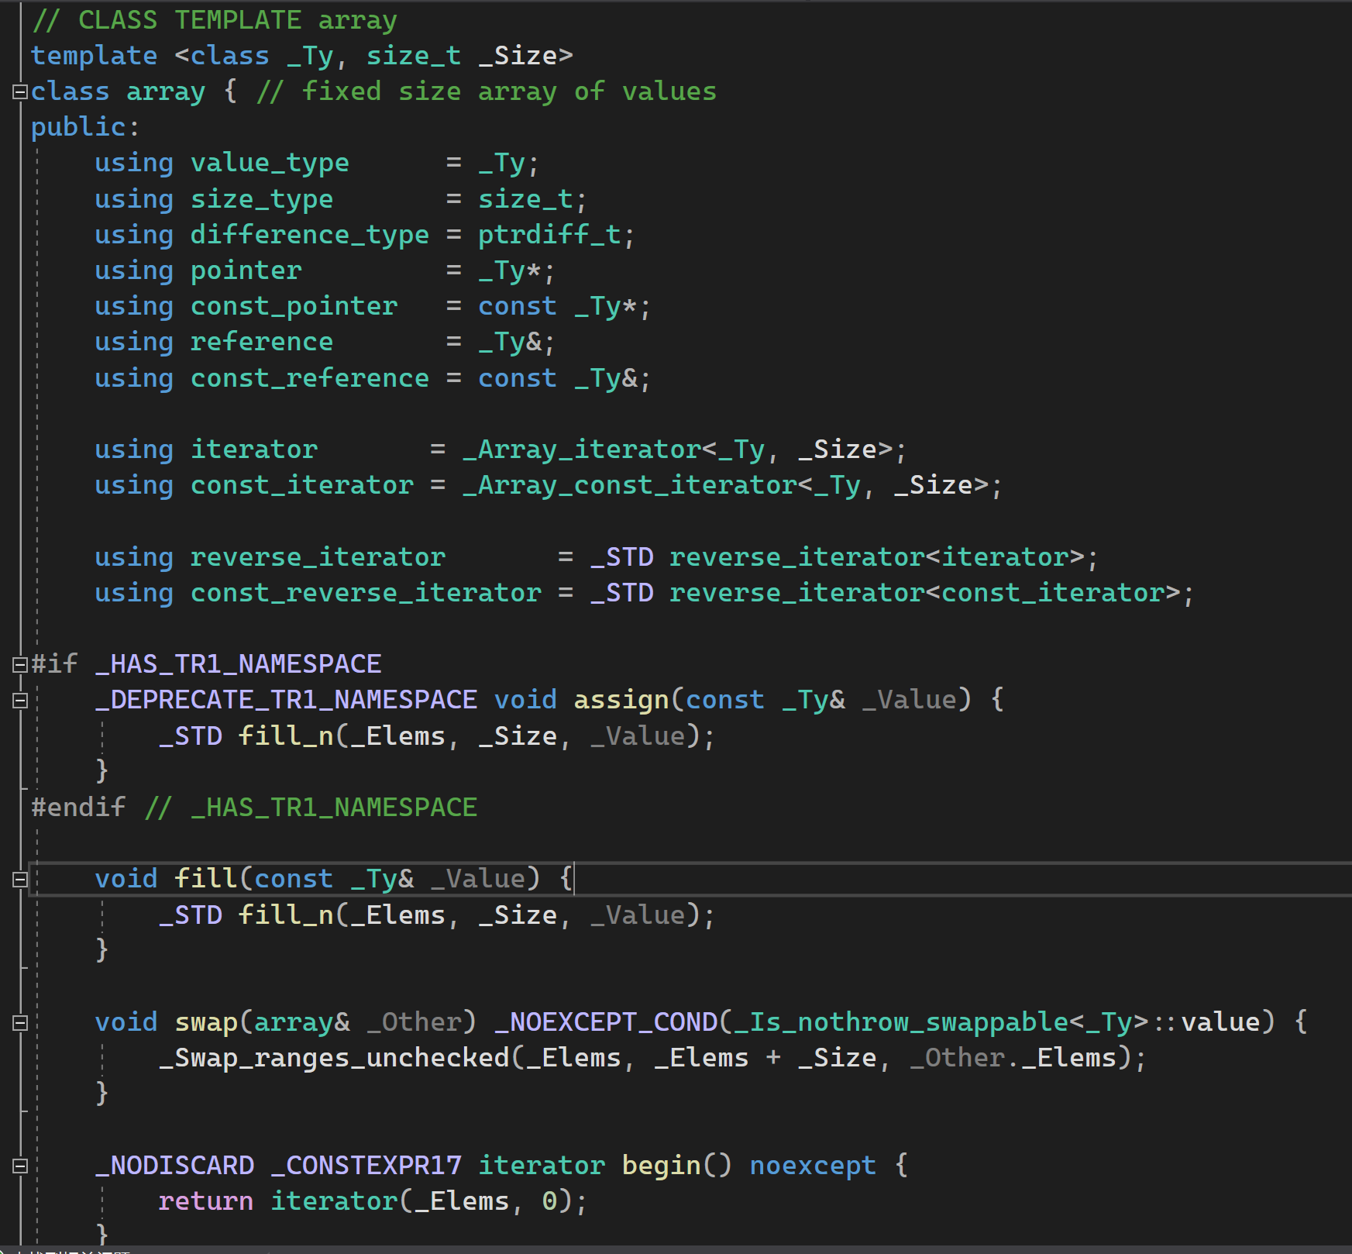
Header-only LIB? => All template libs like STL.

Slide 10
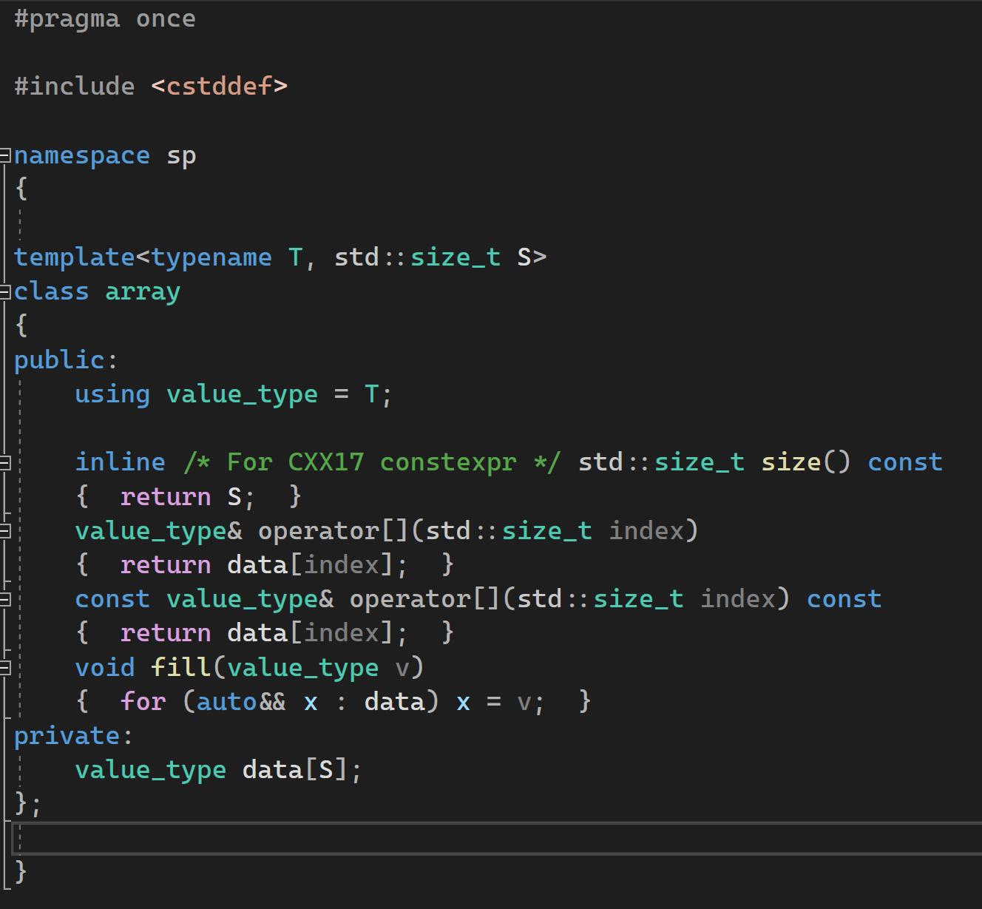
Simple Header-only Array

Slide 11
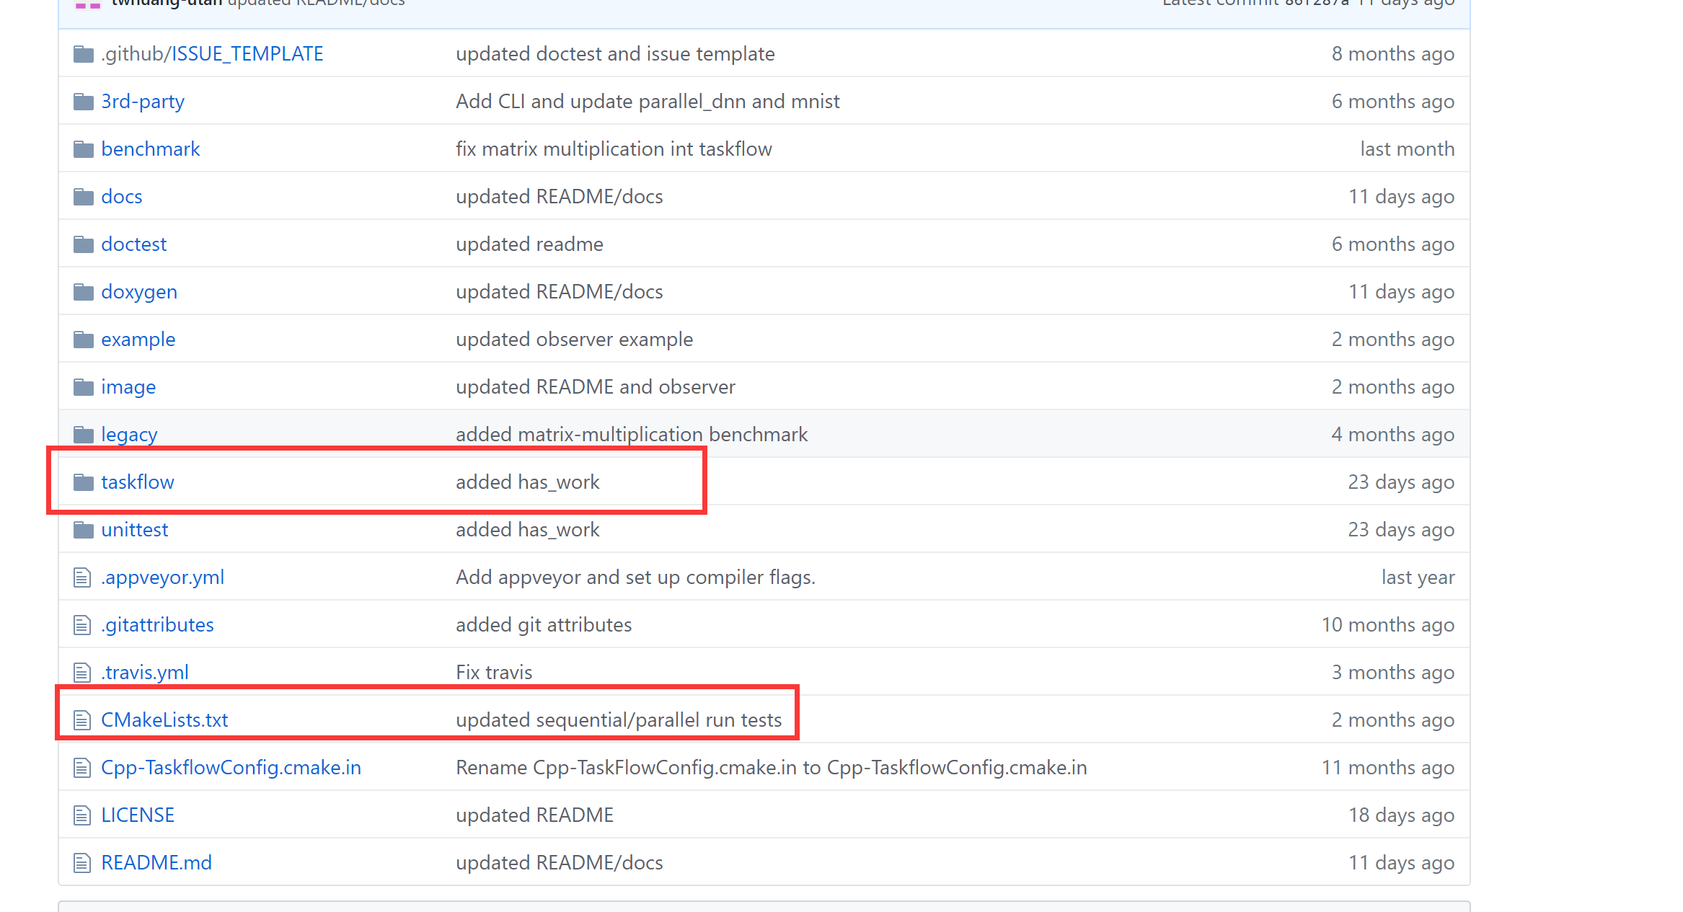
Common File Arrangement For Header-Only Libs

Slide 12
Classifier
/03

Slide 13


Samples
Positive sample
Positive sample
Input Image
CLASS = CLASSIFIER( )

Slide 14
Template Based Method
Positive templates
Input Image
Use some compare function to find out best-match one.
(Kind like KNN which K = 1)
Negtive templates

Slide 15
Details
template
input
input
Positive templates
gain[k]
Negtive templates
*tem | *inp | gain
0 | 0 | 0
1 | 0 | 1
0 | 1 | 1
1 | 1 | 3
If all_positive_gains < low_bound:
Match->negative;
gain[0, 1, 2, ..., N]

Slide 16
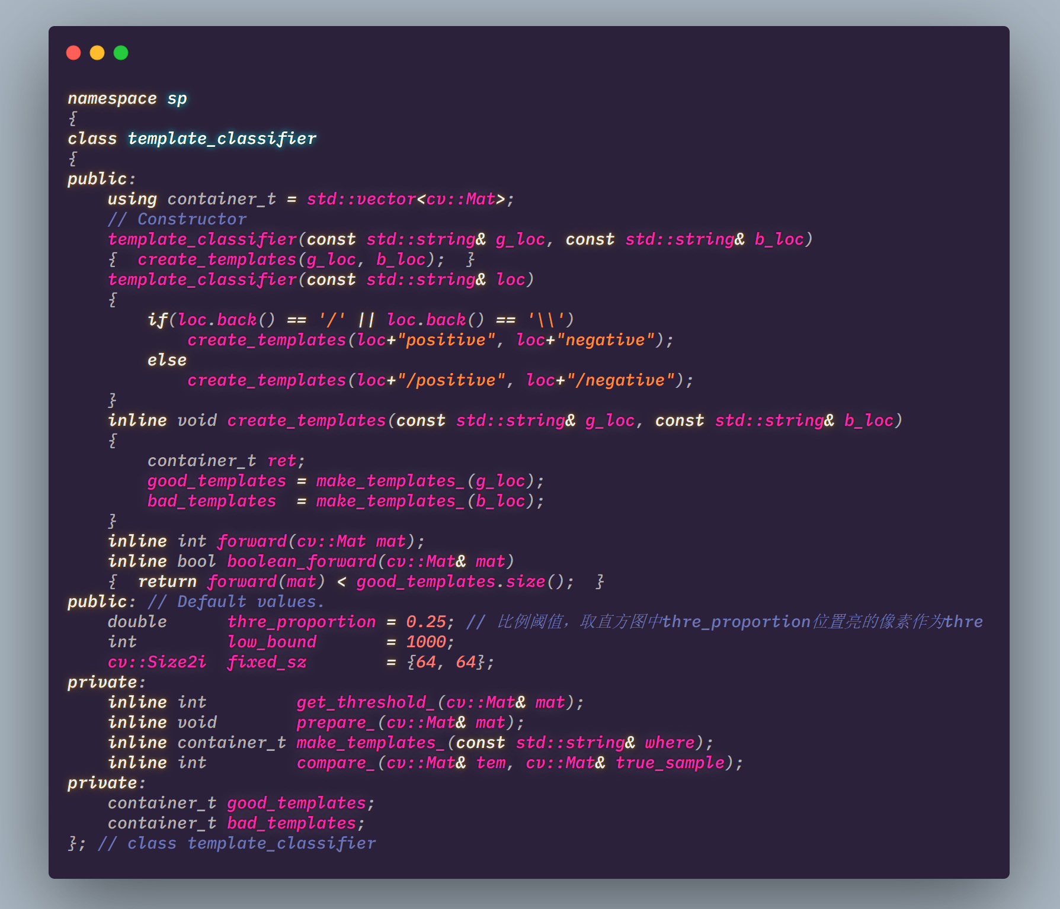
Workflow - begining
Positive templates
Negtive templates
Read them in gray scale(imread);
Store them in container;
Resize & thresholding(prepare_);

Slide 17
Workflow
Input image
Compare input and templates.

Slide 18
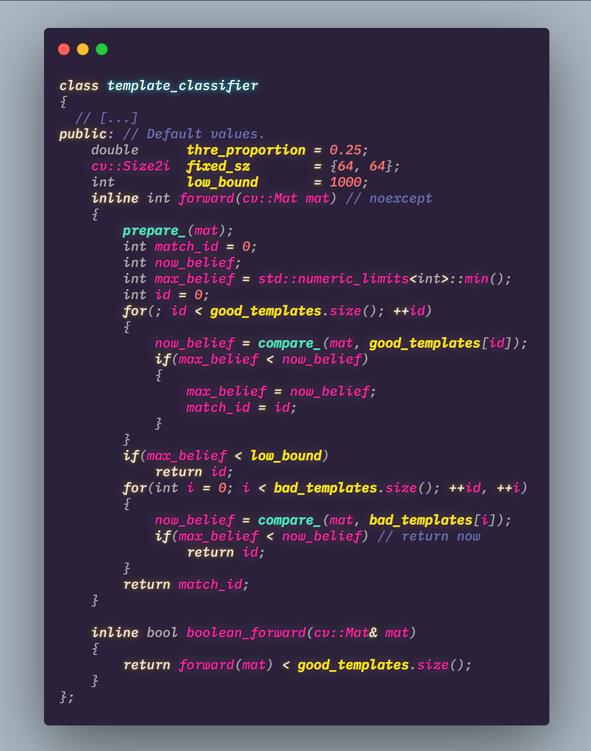
Forward
0
1
Good …
2
match_id
3
Bad …
4

Slide 19
Requirements
Header-Only Lib.
File arrangement: Slide 11.
Minimum API: Slide 17.
Good test cases.
Code specification in Chapter 1.
[Bonus]: Parallel Processing using multi-threading(a thread pool is better).
https://github.com/ganler/superpower19classifier/blob/master/classifier.hpp
But you’d better try to do it with you own.
Make sure you can explain each line you write before you pull requests.

Slide 20
MSER
/04

Slide 21
使用MSER寻找灯条
最大稳定极值区域（Maximally Stable Extremal Regions，简称MSER）是在计算机视觉领域中一种用于在图像中进行斑点检测的方法。这个方法由Matas等人^{[1]}提出，用于在两个不同视角的图片中寻找对应关系。这种方法从图像中提取全面的元素对应关系，有助于宽基线匹配（wide-baseline matching），以及更好的立体匹配和物体识别算法。(wiki)
https://docs.opencv.org/master/d3/d28/classcv_1_1MSER.html

Slide 22
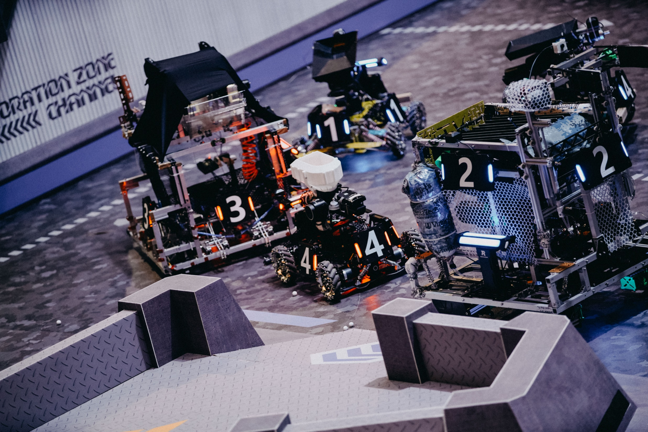

Slide 23
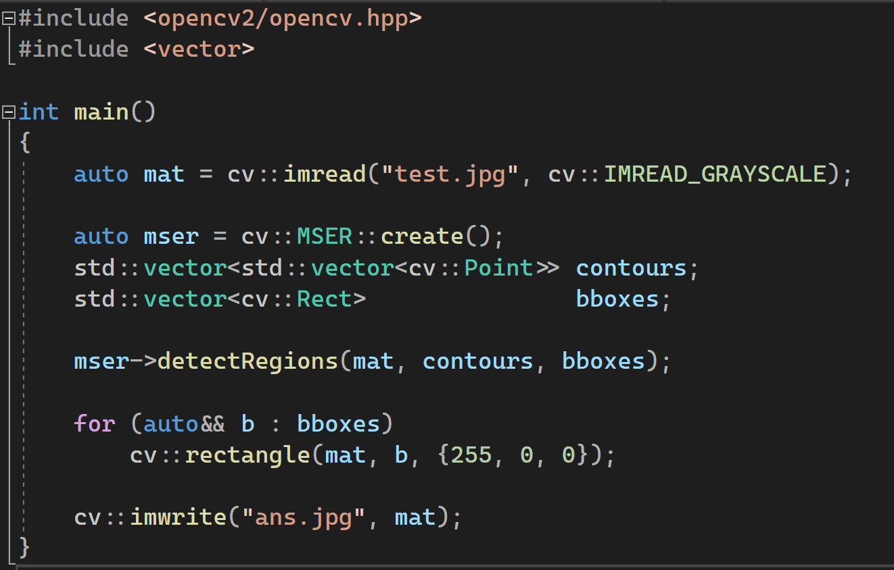
First Try

Slide 24
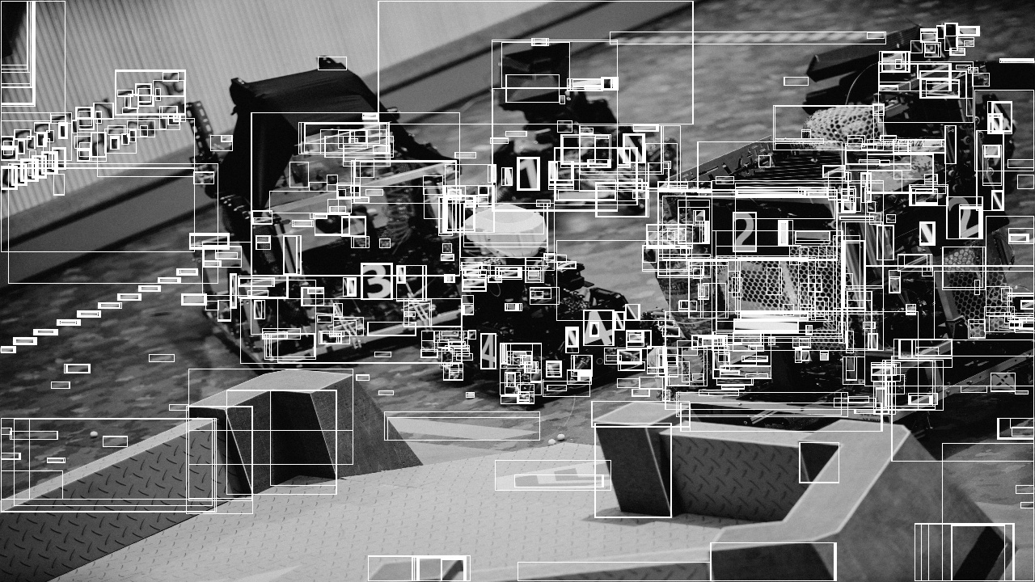
\
2603 BBOX

Slide 25

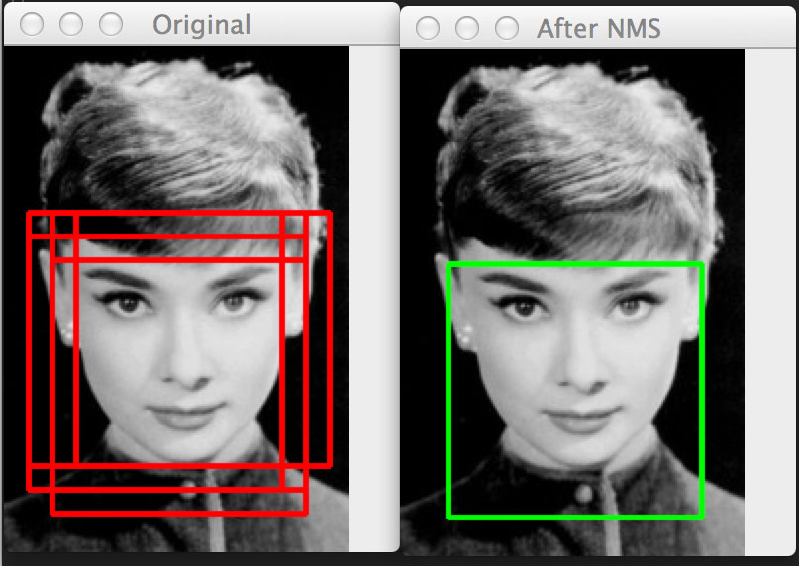
Too Many Boxes? => None Maximum Supression

Slide 26
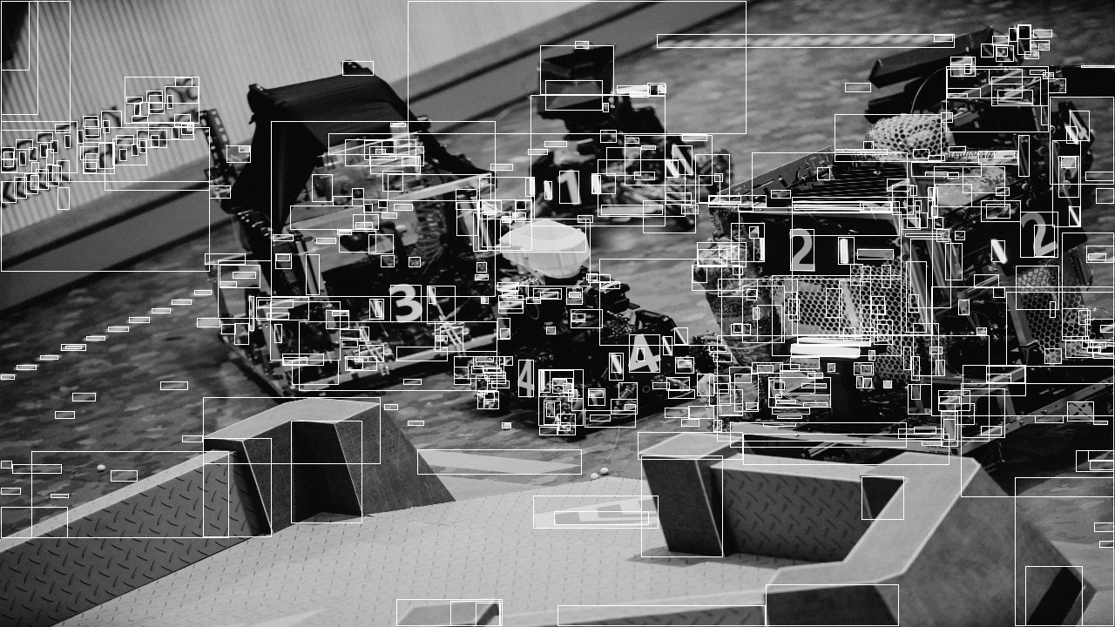
521 BBOX

Slide 27
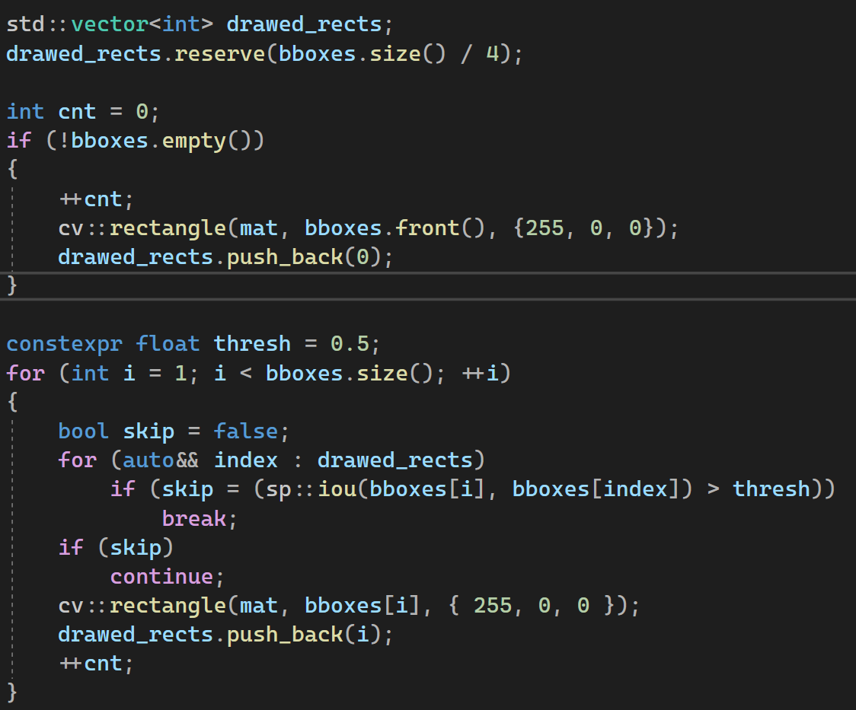
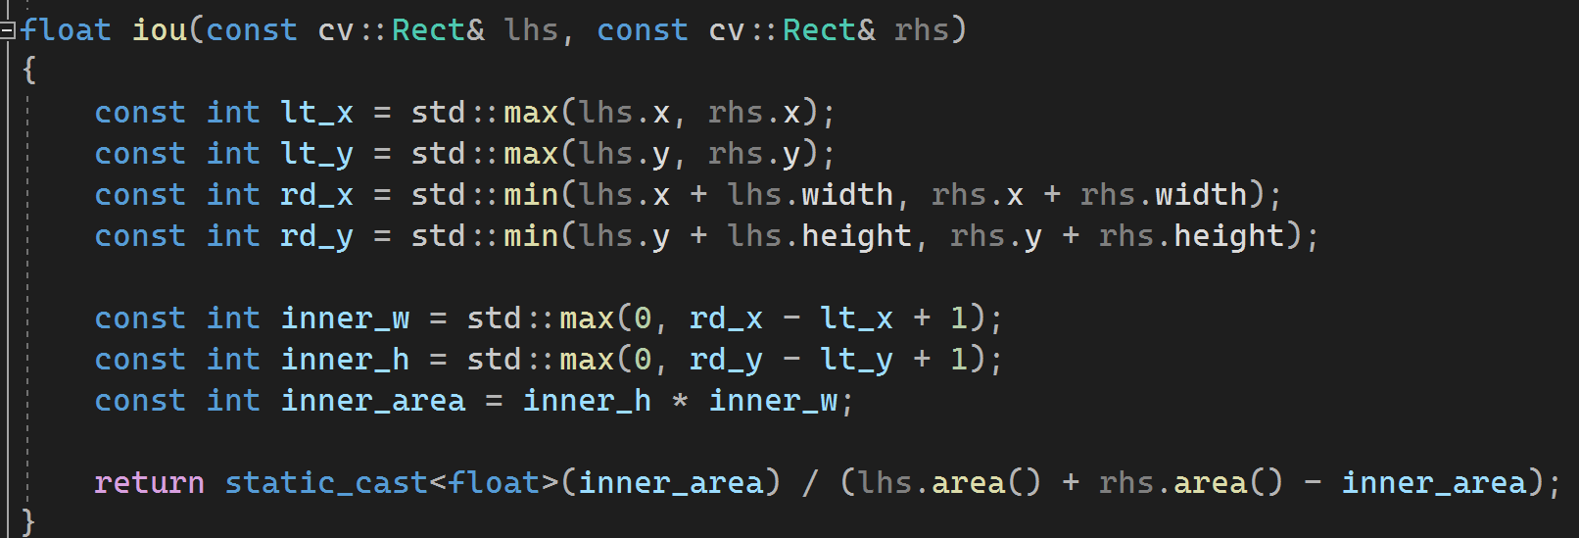
IOU implementation
https://paste.ubuntu.com/p/NWVNJVMPgd/

Slide 28
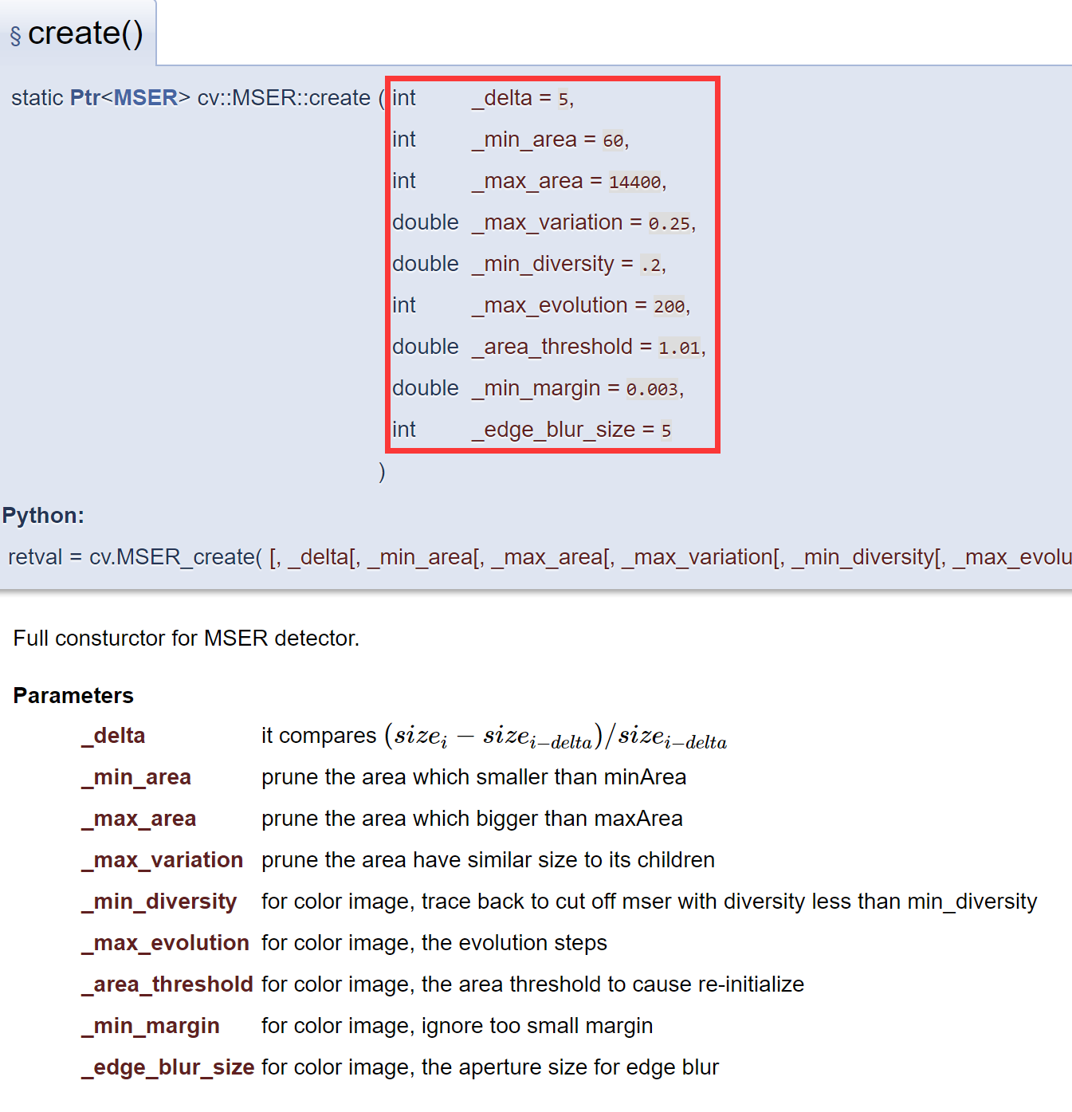
Maybe we should use the parameters.
https://www.youtube.com/watch?v=O0HkgXB_KY4
J. Matas, O. Chum, M. Urban, and T. Pajdla. "Robust wide baseline stereo from maximally stable extremal regions." Proc. of British Machine Vision Conference, pages 384-396, 2002.
https://blog.csdn.net/datase/article/details/72331031

Slide 29
ASSIGNMENTS
[A whole project] Template classifer.
[MSER.cpp] Use some strategies to make bbox num of test.jpg as less as possible while keep all the lights.(output image, bbox num and your .cpp code)
DDL
2019/10/18/23:59
Once you finished, send your assignment(${NAME}.zip) to 814761970@qq.com .
Notes:
iSlide，让PPT设计简单起来！
iSlide, Make PowerPoint Design Simple!

Slide 30
std::quick_exit(0);
Notes:
iSlide，让PPT设计简单起来！
iSlide, Make PowerPoint Design Simple!

